Slide 1
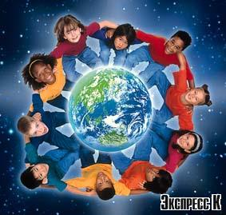
Our Earth is very beautiful. It has a lot of rivers, lakes, oceans, cities and hospitable people. A man is a part of nature!

Slide 2
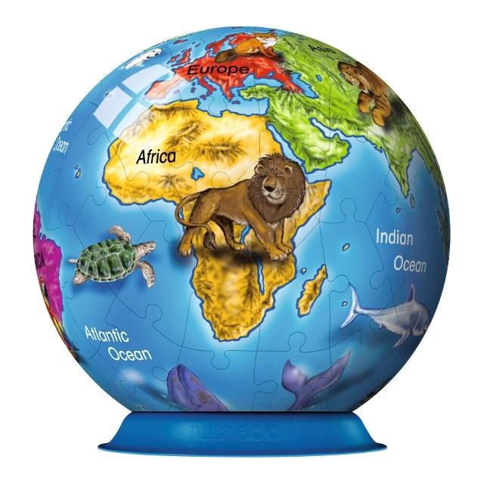
Animals play
an important role in human`s life.

Slide 3
PHONETIC EXERCISES
[æ] рarrot, cat, kangaroo, panda,
rabbit, camel, rat, antelope.
[dz] giraffe,
[t∫] chicken, cheetah,
[Ͻ] dog, horse,cock,crocodile, frog, peacock

Slide 4
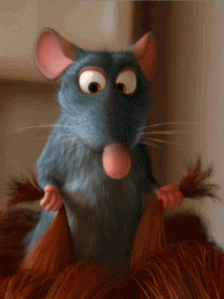
“I like white mice; they are very nice.”

Slide 5
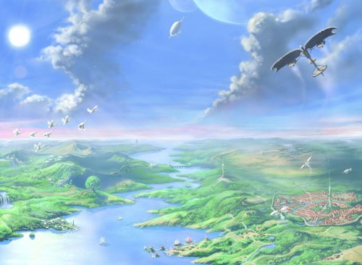
«My Dream» by Gillian Brown
I love all kinds of animals
Dogs and cats and rabbits,
I love all kinds of animals
Despite their little habits.
If I had tons of money,
Do you know what I would do?
I would buy lots of animals
And have my own zoo.
But they wouldn’t be in cages
They would be free to run around.
And there’s one thing they would feel
And that is safe and sound.

Slide 6
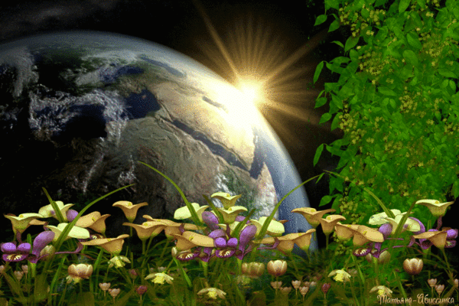
«The Earth.
We are guests on it.
Animals
around the world»
Earth.
We are guests on it.

Slide 7
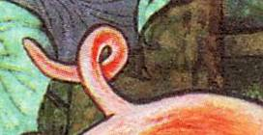
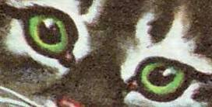
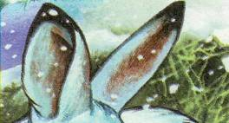
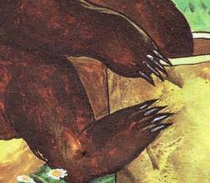
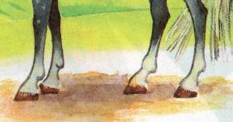
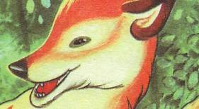
Look and say
Whose tail is it? | Whose eyes are these? | Whose ears are these?
Whose legs are these? |  | Whose head is it?
Whose paws are
these?

Slide 8
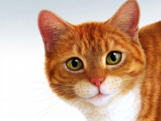
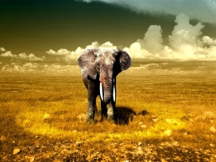
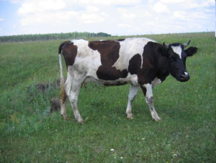
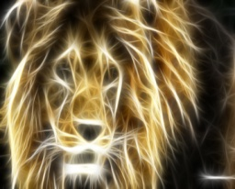
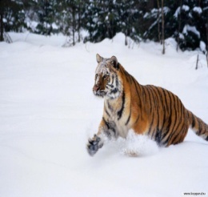
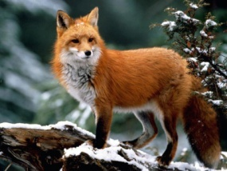
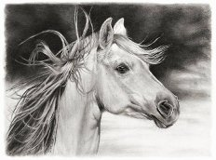
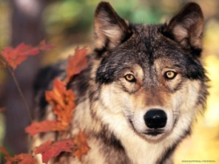
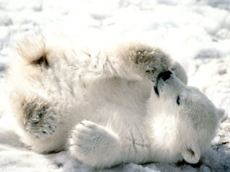
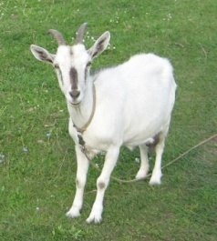
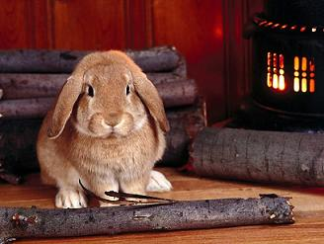
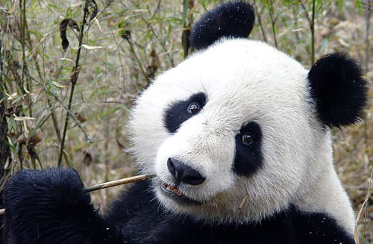
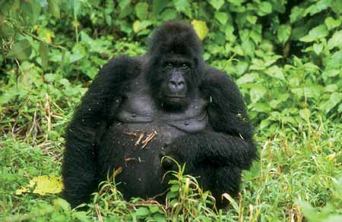
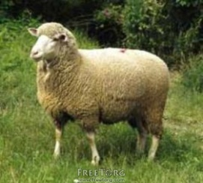
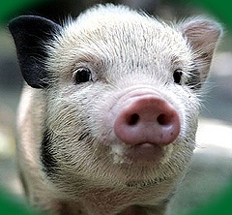
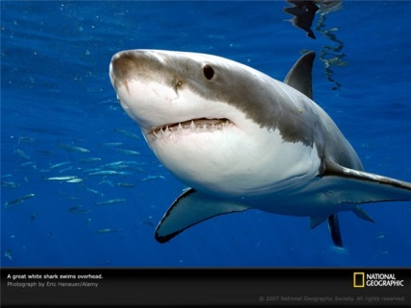
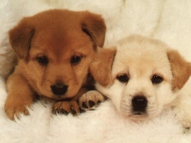
Animals
Domestic Wild

Slide 9
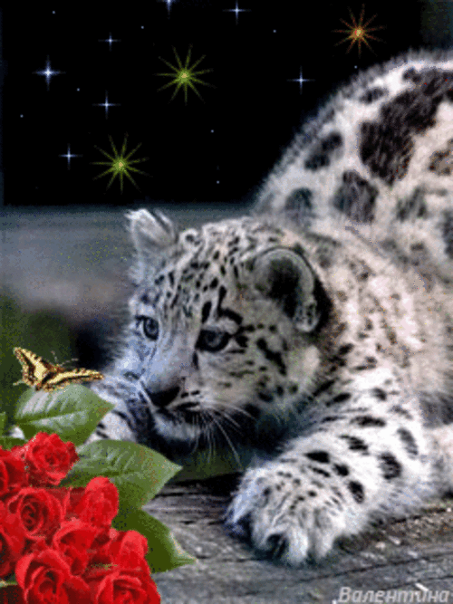

Listening

Slide 10
Write the names correctly:
god, nilo, getri, nomeky, omuse, sohre, rabe, shpee.
Dog, lion, tiger, monkey, mouse, horse, bear, sheep.

Slide 11
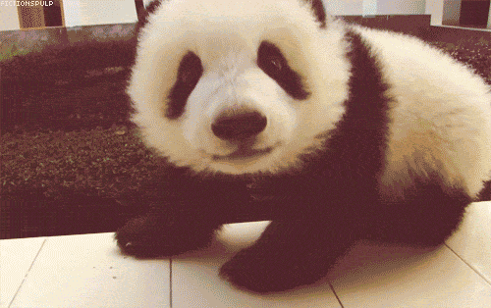
Describe these animals,
using as many adjectives as possible:
( strong, big, small, fat, clever, cunning, slow, quick)

Slide 12
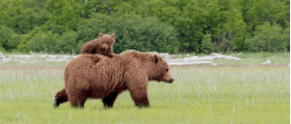

Slide 13
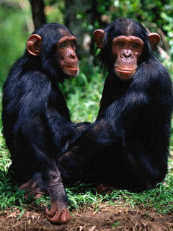

Slide 14
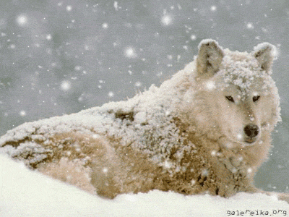

Slide 15
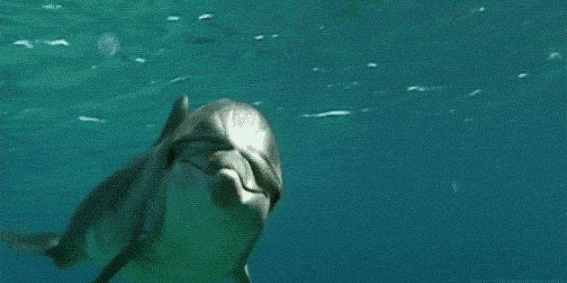

Slide 16
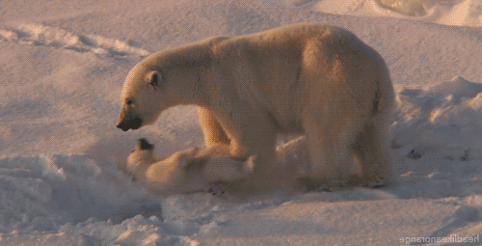

Slide 17
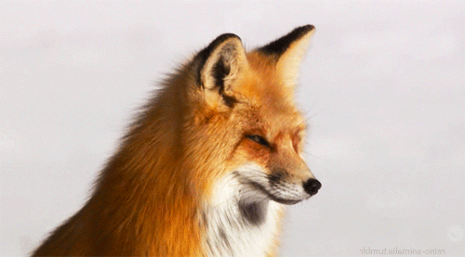

Slide 18
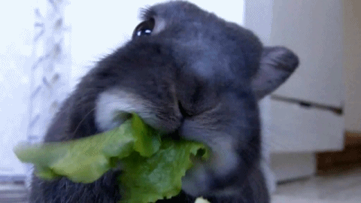

Slide 19
Describe these animals,
using as many adjectives as possible:
( strong, big, small, fat, clever, cunning, slow, friendly, hungry)
A panda is …
A bear is…..
The polar bear is……
A fox is……
A wolf is…..
A monkey is……
A rabbit is …..
A dolphin

Slide 20
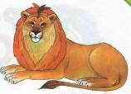
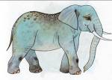
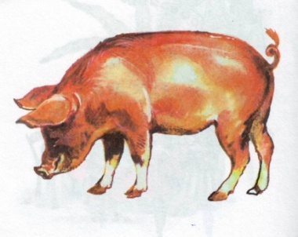
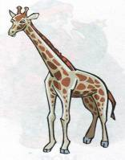
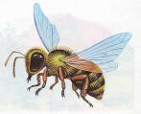
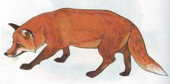
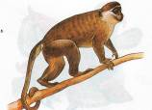
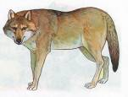
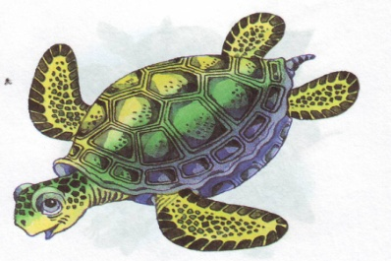
Finish the saying
As hungry as ...
As brave as ...
As cunning as ...
As heavy as ...
As dirty as ...
As tall as ...
As busy as ...
As funny as ...
As slow as ...

Slide 21
Crossword
“Do you know these
animals”

Slide 22


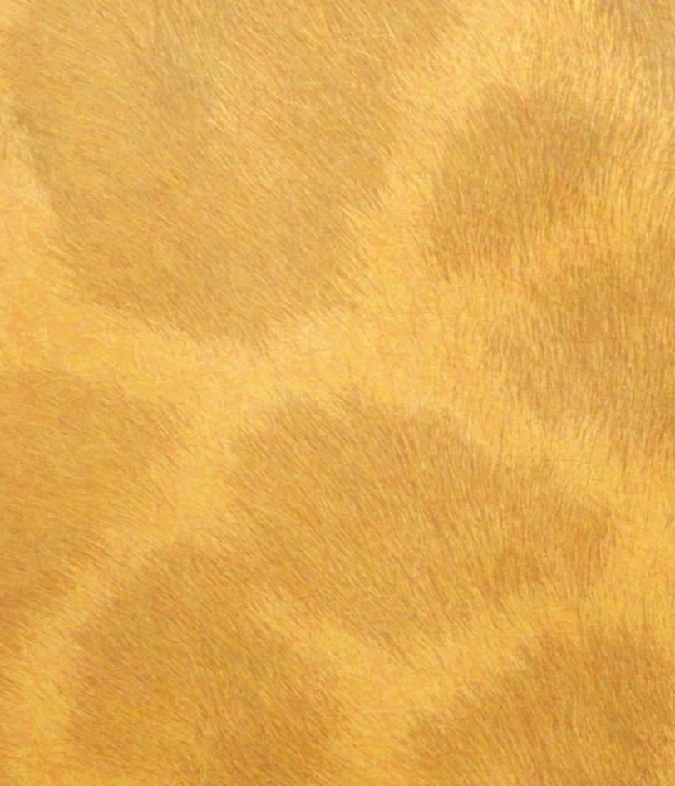
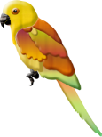

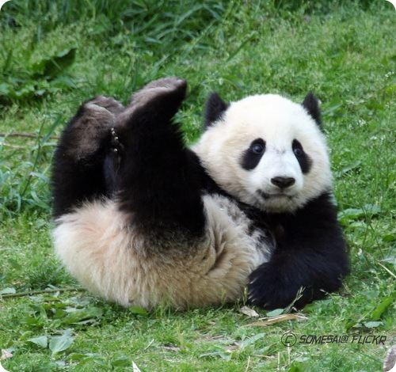
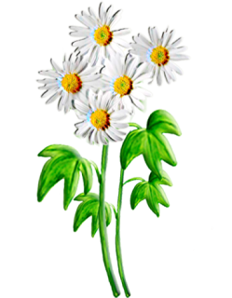





What is this
animal?
X
panda
The giant panda is a large black and white wild animal. It is a national treasure in China. Some pandas are much smaller and look rather like a large cat with a bushy tail and a pointed nose. The Chinese call their beloved pandas "large bear-cats.“
.
?
P
A
N
D
A
i
GUESS?
NEXT

Slide 23


What is this
animal?
X
SNAKE
A snake is a crawling animal with a long body and no legs. Living snakes are found on every continent except Antarctica and on most islands.Some snakes are dangerous because they have a poisonous bite. Poison can cause painful injury or even death to humans.
?
P
A
N
D
A
S
N
A
K
E
i
GUESS?
NEXT
In the Western worldl species. They require minimal space, as most common species do not exceed five feet in length. Pet snakes can be fed relatively infrequently, usually once every 5–14 days. Certain snakes have a lifespan of more than 40 years if given proper care.
Symbolism

Slide 24

What is this
animal?
X
OTTER
The otter is a furry web-footed swimming animal. River otters eat a variety of fish and shellfish, as well as small land mammals and birds. Sea otters eat shellfish, clams and sea urchins.
Sea otter's life is occupied with the cleaning and taking care of its fur. If the fur is damaged otter may die from cold and exposure.
?
P
A
N
D
A
S
N
A
K
E
O
T
T
E
R
GUESS?
i
NEXT

Slide 25

What is this
animal?
X
The perfect pocket pet
The mouse is a small rodent that is found in all corners of the globe, even in Antarctica.
Many people today like to keep the mouse as pets because of the small size and quiet temperament of the mouse. The mouse is also used a lot in scientific research though the mouse is not an easy animal to examine.
?
P
A
N
D
A
S
N
A
K
E
O
T
T
E
R
M
O
U
S
E
i
GUESS?
NEXT

Slide 26

What is this
animal?
X
a Few Facts about horses
Location: Pretty much worldwide.
Special Features:
Domesticated since ancient times.
Average life span 20-25 years. A horses' field of vision is 300 degrees.
Sensitive skin which responds to touch.
Can weigh up to 1000 pounds.
?
P
A
N
D
A
S
N
A
K
E
O
T
T
E
R
M
O
U
S
E
H
O
R
S
E
GUESS?
i
NEXT

Slide 27

What is this
animal called?
X
SHEEP
A sheep is grass-eating animal covered with thick wool.
Sheep are most likely descended from the wild mouflon from Europe and Asia. Sheep are raised for their meet, milk and wool.
?
P
A
N
D
A
S
N
A
K
E
O
T
T
E
R
M
O
U
S
E
H
O
R
S
E
S
H
E
E
P
i
GUESS?
NEXT

Slide 28


P
A
N
D
A
S
N
A
K
E
O
T
T
E
R
M
O
U
S
E
H
O
R
S
E
S
H
E
E
P
ИСТОЧНИКИ

Slide 29

There is only one way protecting
animals and birds in danger
To open more national parks
To build new roads according to a natural-saving technology
To plant more new forests
To cut pollution
To use natural resources more rationally

Slide 30

Have a Nice day!

